Slide 1
WELIKE
PROJECT

Slide 2
PREFACE
It has been a great pleasure to have been invited to present ‘Project – WeLike.’
I thank Prof. Rajesh Aparnath - Head of DLP, Hybrid Programme, Prin. L. N. Welingkar Institute of Management Development & Research.
I also thank the entire Teaching Staff as well as the Non -Teaching Staff of the Institute.
The theme behind ‘Project – WeLike’, an innovative subject where learning of management concepts takes place through video based teaching methodology.
It includes referring video content from “WeLounge”, “WeTube” and “Newswire”. Effectively and Efficiently use the online amenities provided and understand it. Present it creatively and innovatively.
I owe acknowledgment and inspiration to www.welingkaronline.org site and all the people behind keeping this site online 365x24x7.
The text in this MS - PowerPoint Presentation has been drawn from this site and is structured as per “ Guidelines for Project WELIKE”.
Thank you all for this wonderful experience.
Sandip Gujar PMP®

Slide 3
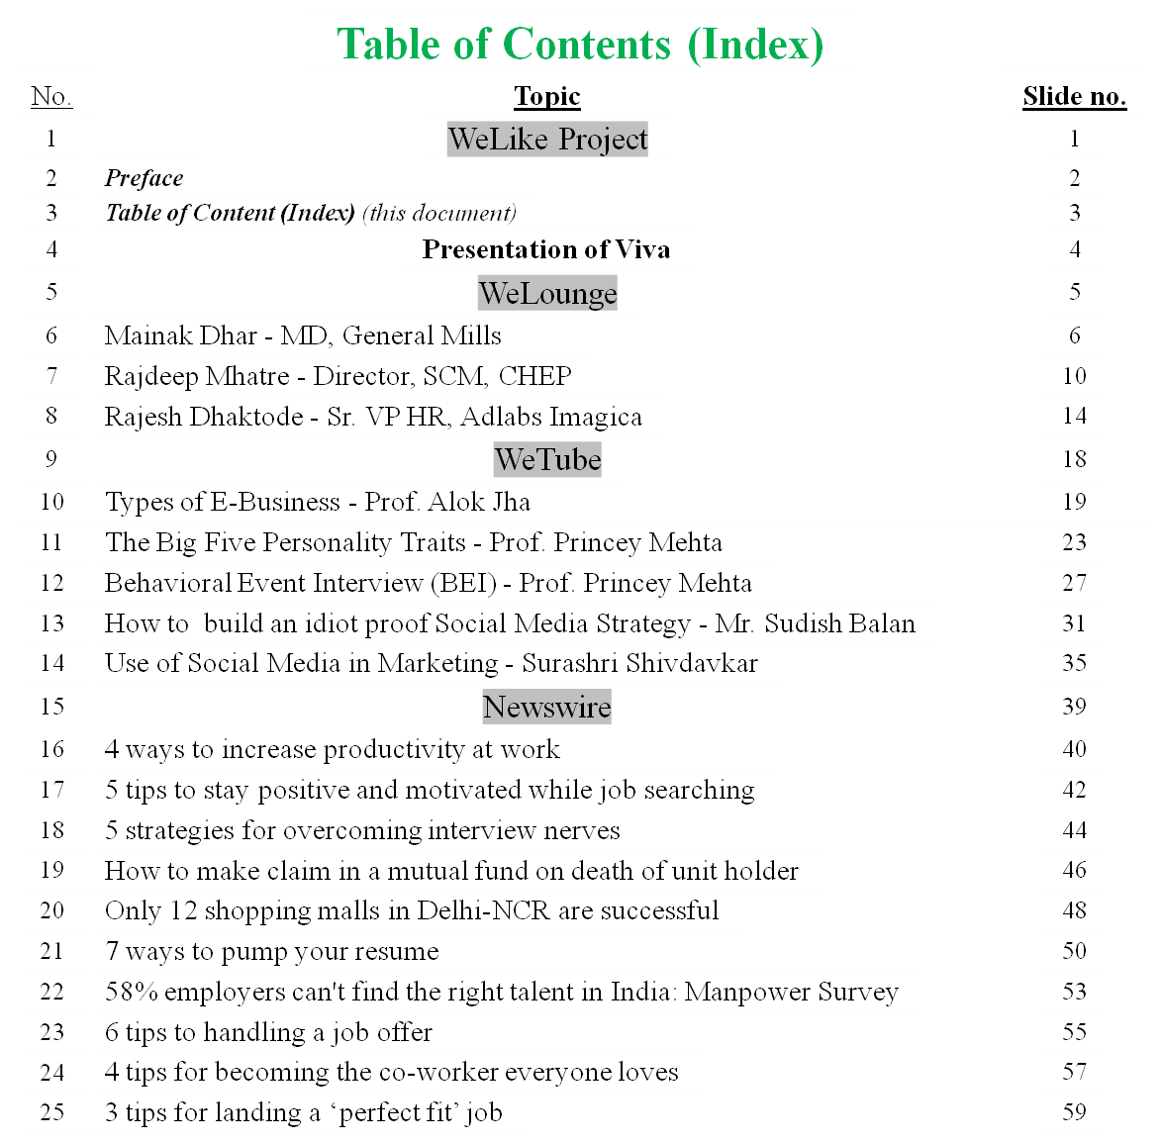

Slide 4
Presentation For Viva
Sandip Gujar PMP®
ID : HPGD/JA15/0102
Semester : II
(sandipg3@outlook.com)
Prin. L. N. Welingkar Institute of Management Development & Research

Slide 5
WELOUNGE

Slide 6
MR. MAINAK DHAR
MD – General Mills

Slide 7
Learning's:-
Mr. Mainak Dhar MD, General Mills - A self confessed cubicle dweller by day and a passionate writer by night.
With 2 decades of experience with blue chip organizations like Procter & Gamble (P&G) and now with General Mills.
Mr. Dhar has extensive experience in leading multi disciplinary teams to drive sales and profit growth across a broad portfolio.
He possesses a diverse experience set across emerging/developing markets, whitespaces/turnarounds and in managing long term equity/innovation and short term business delivery.
His key ‘points of difference’ are driving ruthless focus on winning external v/s internal transactions, simplification and building strong organizational capabilities.
His professional goal was to keep stretching business and leadership experience to progress his career while at personal level his key goal was to ensure that despite increasing responsibilities and challenges at work, he had to keep his balance.
His passion: to develop strong organizations and have a legacy, not just to deliver the numbers.
His writing, both helped him keep his mind fresh and reminded him that there’s always more to life than the job ‘thinking out of the box.’
Professional journey: ‘He felt it amazing at every stage of the career,
he learned something new and grew both individually as well as professionally.’

Slide 8
He started his career with a 3 year stint at P&G, Mumbai; straight out of campus of IIM Ahmadabad.
For spending 18 years at P&G there were 2 big driving factors – First-Organizationally there was a good sync of values in terms of commitment, really doing the right thing for consumers in the community and long term commitment to building businesses and organizations. Second- He was fortunate to have a very diverse experience, to work across different markets, different categorizes, work with different people, different cultures, backgrounds and nationalities and not for once did he feel that he was not learning something new.
On turning around businesses which were large and complex – He believed in managing tough business situations as he does not just focus on ‘What’ or ‘Numbers’ or ‘Results’ but importantly focuses on ‘WHY’. Why are the results being delivered the way they are? Is it unclear priorities, resource issues, capability issues? Fix them once to get sustainable results. In short term underlying issues are not fixed.
As many people never talked about ‘WHY’ he talked about the values and the fit he had at P&G, could repeat the same at General Mills. Ramping up with growth, set ambitious targets, building a lot of foundation capabilities he saw an energized enthusiastic organization.
Mr. Dhar learned 5 languages including French (learned in Canada) and Thai (learned when he spent 5 years in Thailand).
Since 11, he wanted to write, and he wrote ‘Alice in Deadland’ series of 8 books. These were auctioned by an US studio to make a TV series.

Slide 9
About Mr. Dhar’s passion for writing – would find time to write even while waiting at airport lounges and half hour at night regularly. His personal favorite self written book ‘Fundamentals of Mixology’
He thinks work is 1 part of life as he plays roles of a father, a husband, a friend; he gives justice to all roles.
On values he says set values correctly – give a guiding light towards why are we doing what we are doing. Central value is do the right thing and do it for a long term.
Core Value is ‘win as a team in a collaborative atmosphere’.
On achieving results he believes in understanding the consumer and their needs. Delight them over a period of time and empathize them.
Regarding the emerging trends at General Mills Mr. Dhar states - 1.Variety in Food, 2. Health from food and 3. Authentic taste and experience in food as people don’t have time.
By providing additional value from General Mills he emphasized on being a trusted, dependable partner for a long term and have a win-win partnership.
Key drivers for General Mills – growth coming from putting consumer first, getting more consumers, engage with the consumer, understand their needs and giving them empathy (an important strategy).
‘Creating trust through our brands/portfolios helps as an ongoing source of results and helps to grow fast.’
In five years from now Mainak wants to be the ‘best father’,
the ‘best husband’ and the ‘best person for people at work’.

Slide 10
MR. RAJDEEP MHATRE
Director – SCM, CHEP

Slide 11
Learning's:-
Mr. Rajdeep Mhatre, Director, Supply Chain Management (SCM), CHEP. A hardcore SCM professional, setup Distribution and Logistics network for CHEP at Pan-India level.
Mr. Mhatre specializes in setting-up Warehouse & Distribution Solutions, Planning and Analysis, Vendor Management, Contingency Planning, Managing Cold-Chain, Retail and Wholesale.
His 23 years professional journey has been highly enriching and as he says – ‘the experiences have changed me a lot, made me a better human being, profession has sharpened me and all along have built professional relationship’. The basic element of this experience was hands-on.
He started as a store keeper, keeping track of inbound and outbound at Konkan Chemicals. He got into SCM as a professional with RadhaKrishna Foodland (10 years). He got experience with Metro Cash-n-Carry, Bangalore (3 years). Joined CHEP in 2000 as a Project Manager (for 3 months only).
He volunteered for HOD’s role and was entrusted the job. In a year, he had additional charge of International Logistics and Operations. That added to his portfolio and future growth came.
In a few years he got promoted to Director position and achieved
great experience in 4 years of global exposure.

Slide 12
He shared best practices, interacted and contributed to global projects. He got big opportunities to work with global giants like Unilever Snorr.
Mr. Mhatre talked in detail about CHEP. It being a global supply chain helping customers to move, operate, store and protect their products operating in 45 countries, collecting, repairing and reissuing more than 280 million pallets (A portable platform for storing or moving goods that are stacked on it) globally.
Mr. Mhatre added that in March 2008, CHEP commenced in India. In 7 years CHEP has 350+ customers, 35 warehouses, 5 regional offices, 100+ employees and 14 awards in supply chain, HR, manufacturing, innovation, almost all domains. It was a remarkable achievement.
Regarding challenges in the next 5 years, Mr. Mhatre stressed on continuous cost improvement (reduction) and adding more value to the customer. CHEP has started standardization of equipment and process and complies to all Government set regulations.
Mr. Mhatre emphasized on not doing anything illegal and safety as topmost priority. This gives customers peace of mind. CHEP is with customers and its measured on parameters like environment friendly, value creation, sharing the value and then splitting it equally.
‘We don’t sell a product, neither do we position a price, we only lease’- added Mr. Mhatre.

Slide 13
Mr. Mhatre stressed on proper planning and providing value proposition for supply chain management to be effective for end customers.
Whilst talking on competitors, Mr. Mhatre stated that no competitor is organized or offers all products under one roof as CHEP did. Small suppliers in far off regions, doing their bit were integrated or bought to grow and expand by CHEP.
Talking about challenges ahead, he said challenges continue as growth is 200% , CHEP creates standards and more mechanization is on but GST, 550 tolls (10 minutes wait time for trucks at each toll), wastage of 10 million liters' of fuel, etc. are to be taken care of.
On what is CHEP doing differently, Mr. Mhatre said that as there are skill set gaps, non standardized equipment, taxes (different taxes at different places) and tolls (different tolls at different places) CHEP offered standardizations, also designing trucks to help industry, integrating manufacturers, distributors, retailers, customers, etc. to link overall supply chain. This direct interaction with end customer is time saving, cost saving and is efficient for all.
Mr. Mhatre has recruited a young, energetic team and draws synergy from them. He is trustworthy and adheres to commitments made.
He believes – ‘there is no shortcut to success. Dedication and hard work are the 2 wheels of success’.
He suggests, for people entering SCM, to ‘get hands-on experience
in first 5 years and don’t jump the ladder but climb it’.

Slide 14
MR. RAJESH DHAKTODE
Sr.VP HR – Adlabs Imagica

Slide 15
Learning's:-
Mr. Rajesh Dhaktode is a Sr. VP HR, Adlabs Imagica.
He has done a hotel management course with catering technology and applied nutrition, a 3 years diploma in marketing management, Masters in Tourism and a MBA in HR and Finance.
Started his career with Oberoi flight services, moved on to RadhaKrishna hospitality services for 4-5 years in the Middle East. In PLO Cruisers he was managing their catering services and moved into HR with training and added payroll responsibilities for 8 years.
Mr. Dhaktode pursued tourism and as HR was his passion did an MBA in HR. To understand payroll better he also opted for MBA in Finance.
He experienced that people had competencies, but were required to apply the skills and perform on the job.
At Adlabs Imagica, Mr. Dhaktode heads HR as SR.VP and is the most trustworthy and reliable member of the team.
He adds, HR needs to come out from the functional role to understand the core competencies of business. Till such time he believes that it is a shared service and a back-end function, not a core business partner.
He further adds, people opt for HR as a last resort, as its more administrative (salary processing, leave/attendance management, training and development and personal management service).

Slide 16
Mr. Dhaktode said that to energize the synergy, need to have 70:30 ratio where 70 adds value to an organization while 30 adds value to day to day routine.
Adlabs Entertainment Ltd. came out with India’s first Entertainment theme park Adlabs Imagica, which is worth people’s time and money and as per Mr. Dhaktode it’s a revenue generator, as its for all from 5 to 75 years.
Talking about the technology role he said, 'its imagining the magic with 25 theme driven rides, 6 world class restaurants, a water park -Aqua Magica, hotels for overnight stay, its integration of various industries’.
As Head HR, Mr. Dhaktode manages 2000+ employees, flexible workers, college students and school children who contribute to sales.
About the HR policy, he says, it has challenge to get the right kind of skill set as there is extensive 6 months hiring process. No industry is as close to the operations of Imagica!
Mr. Dhaktode contributes in trainings on customer care – guest facing, imparting product knowledge, safety do’s and don'ts.
Under his able guidance, trainings on operations of rides, understanding the engineering – functions and the holistic development of a
candidate, are taken care of.

Slide 17
Mr. Dhaktode explained that do not have any tie-ups with any B-schools its a new concept. Retaining people is the biggest challenge .
They prefer candidates who are aware of crisis management and interacting with people skills.
He added that this a new industry in India has been built by an Indian, is Theme based and unlike Disney or Universal there exists a connection. Get international quality and Indian enjoyment in food or theme rides.
While comparing Imagica with other competitors like amusement parks and water parks Mr. Dhaktode mentioned that safety and customer service is the major differentiating factor. They have specialized medical centers to attend to any exigencies. In one ticket – avail all rides. The whole day’s journey does not get compromised.
He mentioned that the entertainment park with family, is their USP. One can see happiness on faces of people and spread happiness. It’s a place which gives happiness and enjoyment without any age restrictions.
On a message to Welingkar Students he said,' Success is what you do to yourself and you attract it. Hard work is required everywhere but dedication is most important to do anything’.
‘Hard work and dedication can get you where you want to go. Stay grounded, stay humble and do not give up on yourself. To come out winning, you need to go through lot of sacrifices.’
‘Unless and until sacrifices don’t happen you won’t succeed.
Don’t ever give up on anything have faith on yourself.’

Slide 18
WETUBE

Slide 19
TYPES OF E-BUSINESS
By - Prof. Alok Jha

Slide 20
LEARNING'S:-
Prof. Alok Jha, MD CyberPlat, has interacted and provided consultations to a lot of E-businesses and E-Commerce companies.
He explained evolution of phones. Transitions from dial up phones to pagers to mobile phones. Gradually, doing business on mobiles and smart phones.
What is a E-Business?
      Any business that involves the Internet as a platform (medium) to inform and promote a business.
      Any business that communicates to consumers using the Internet.
Types of E-Business
Informative (No payment is involved only information is provided)
Business (Evolved a new type E-Business involving consumers)
Social Platform (Facebook, Twitter, Instagram)
Informative :
      All corporate websites
      University/Educational Institutes websites
      Classified websites
      Government websites

Slide 21
Business :
      Refers to all business that are carried out directly and indirectly with end customers/consumers.
      The Business to Business and Business to Consumer start interacting with each other on Commercial Terms.
  By Commercial Terms we mean:
      I can buy a product or a service
      I can choose what to buy
      I can select what I buy
      On selection I move to pay
      I can pay with all options there itself
This was the birth of E-Commerce globally.
      E-Commerce was the buzzword which provided a platform to people, to buyers and to sellers.
      It ensures that people having a product or service in one geography, can sell their product to multiple geographies without being physically present there.
      Internet made it possible to buy anytime and anywhere.
      India has 5000 to 7000 websites only concerned about buying, selling and facilitating these kind of platforms.

Slide 22
      E-Commerce platforms are categorized into multiple categories.
4 Types of E-Commerce
B2B – Business to Business (Indiamart.com, Tender.com)
B2C – Business to Consumer (Homeshop18.com, Snapdeal.com)
C2C – Consumer to Consumer (Ebay.com, Naaptol.com )
C2B – Consumer to Business (AuctionIndia.com, Elance.com)
Another way to look at E-Commerce (Categorize)
Physical/Tangible Goods (Can touch, feel the product, Instant delivery may not be possible – e.g. from Pins to Television, etc.).
Digital Goods (Do not have mass or volume, Instant delivery is possible – e.g. Movie/Music downloads, wallpapers, eBooks, etc.).
Services (Companies in E-Commerce like BillPay, Travel ticketing, Insurance premium – e.g. Hungama.com, Billdesk.com, Tradus.com, IRCTC.com, etc.).
Why categorize?
    Customers are different in taste, income, etc.
    Different customers have different needs.
    Different people have different skill sets to run different
    kinds of businesses – e.g. technical, negotiation, leadership, etc.
    Every business has its customer base and audience.

Slide 23
BIG FIVE PERSONALITY TRAITS
By - Prof. Princey Mehta

Slide 24
LEARNING'S:-
What is a Trait?
      A trait is an internal characteristic that corresponds to an external position on a behavioral dimension.
      Traits are the consistent patterns of thoughts, feelings or actions that distinguish people from one another.
      Traits are basis tendencies that remain stable across the life span, but characteristic behavior can change considerably through the adaptive processes.
Types of Big Five Personality traits?
In psychology, there are five domains or dimensions of personality that are used to describe human personality. The theory based on the Big Five is called Five Factor Method (FFM).
Acronyms commonly used – OCEAN or CANOE or NEOAC.
What are the Big Five?
      Openness to Experience
      Conscientiousness
      Extraversion
      Agreeableness
      Neuroticism
  OCEAN – Acronym

Slide 25










(Self ratings of single word Adjectives)
Five Traits (OCEAN) | High Scores | Low Scores
Openness to Experience | Curious, Creative, Original, Imaginative, Untraditional, Broad Interests | Conventional, Narrow in Interests, Unartistic, Unanalytical
Conscientiousness | Organized, Feasible, Hard working, Self-Disciplined, Punctual, Persevering | Aimless, Unreliable, Careless, Negligent, Weak-Willed
Extraversion | Sociable, Active, Talkative, Person-Oriented, Optimistic, Fun loving | Reserved, Sober, Unexuberant,Aloof, Task Oriented, Quiet
Agreeableness | Soft-Hearted, Good Natured, Trusting, Helpful, Forgiving, Straight Forward | Cynical, Rude, Suspicious, Uncooperative, Vengeful, Irritable
Neuroticism | Worrying, Nervous, Emotional, Inadequate, Insecure, Anxiety | Calm, Relaxed, Unemotional, Hardy, Secure, Self-Satisfied
(Self ratings of single word Adjectives)

Slide 26
Overview of FFM (Five Factor Method)
The Big Five can be further summarized, as follows:
  Openness to Experience: Appreciation for art, emotion, adventure and unusual ideas, imaginative and curious.
  Conscientiousness : A tendency to show self-discipline, act dutifully and aim for achievement.
  Extraversion: Energy, urgency and the tendency to seek stimulation and the company of others.
  Agreeableness: A tendency to be compassionate and cooperative rather than suspicious and antagonistic towards others.
  Neuroticism: A tendency to easily experience unpleasant emotions such as anxiety, anger or depression.
  Big Five Personality Dimensions
  Openness to Experience – intelligent, imaginative, curiosity, creativity
  Conscientiousness – order, duty, deliberation, self-discipline
  Extraversion – sociability, assertiveness, activity, positive emotion
  Agreeableness – trust, nurturance, kindness, cooperation
  Neuroticism – anxiety, depression, moodiness, vulnerability to stress
This topic covered a large part of what one might want to know about someone’s personality.

Slide 27
BEHAVIORAL EVENT INTERVIEW (BEI)
By - Prof. Princey Mehta

Slide 28
AN INTERVIEW TECHNIQUE USED IN MOST COMPANIES - SELECTING QUALITY EMPLOYEE FOR QUALITY ORGANIZATIONS
LEARNING'S:-
What is a Behavioral Interview?
  To identify and assess the competencies of candidates for a particular job or role.
  To gain information about a candidates past performance and accomplishment that relate to the target job.
  Whether you are seeking to hire, retain or reassign the candidate based on the premise that a person’s past behavior is the best predictor of their future performance.
  This powerful technique is widely used for identifying employees for further development.
Behavioral Event Interview — Competency based selection
(BEI) includes interviewing techniques
What is Competency?
  Competency is a term that describes a pattern or cluster of actions
  that are taken to achieve a desired positive result.
  Observable abilities, skills, knowledge, motivations or traits defined
  in terms of the behaviors needed for successful job performance.

Slide 29
Why use Behavioral Event Interview (BEI)
  The theory of BEI is simple. It considers the best way for an organization to predict an individuals future behavior. Performance is to have the individual talk about past competencies, behavior and performance.
  There are additional benefits to the organization to use a standardized assessment method to measure the qualifications and responses of their prospects.
  Being measureable is increasingly important as it provides consistent, quantifiable proof that the best candidate has been chosen. The decision of the candidate chosen is defendable.
  BEI questions are open ended questions.
How do you a usually analyze the role or position to be filled?
  Skills – talent, technique, absolute action, the way a person did something
  Knowledge – information possessed by the candidate to carry out an action
  Abilities – whether the candidate is able to do the assigned task
  Attitudes – whether the candidate is ready to work on the assigned path
  Experience – whether the candidate has already done an assigned task
  Competency based Training
  Skills + Knowledge + Attitude = Superior Job Performance
  We can upgrade the skills, increase the knowledge by imparting
  training as knowledge is abundant but for attitudes people can only be groomed. Attitudes can never be altered.
Notes:
K

Slide 30







How do you evaluate the candidate using the BEI technique?
Behavioral Interview questions ask:
  Specific Situations – specific not vague, not ambiguous, not as a whole
  Experiences – were you there, have you been a part of
  Specific actions – if situations are specific the action also needs to be specific
  Outcomes – the result
  STAR technique is used to answer Behavioral Interview Questions
Technique | Behavioral Interview Question
Situation | Detail the background. Provide a context. Where? When? What time? What was the situation in detail?
Task | Describe the challenge and expectations. What needed to be done? What has taken place? Why? What was expected out of you?
Action | Elaborate you specific action. What did you do? How? What tools did you use?
Result | Explain the results, accomplishments, recognitions, savings, etc. Quantify.

Slide 31
HOW TO BUILD AN IDIOT PROOF SOCIAL MEDIA STRATEGY
By – Mr. Sudish Balan

Slide 32
LEARNING'S:-
  Social Media – a buzzword, where all want to spend more, as Return On Investment (ROI) is much better than the traditional mediums.
  If you are on Social Media you can make your brand successful, you can sell more and talk to more people.
  Just like any other marketing initiative, you need a solid strategy achieving the goals and to achieve these goals, research and insight is very important.
  Establish a plan
  You need to have a very solid plan to achieve and succeed
  What is a plan?
      What are you hoping to achieve?
      What does success look like?
      What to put in it?
  Create an Editorial Calendar to keep your posting consistent.
  Use an Editorial Calendar
  Create a publishing schedule that helps you maintain a consistent presence.
  Allow yourself to visualize your marketing strategy in a way that everyone can understand.
  Assign writing and other editorial tasks to key members of your
  team.
  Let your editorial calendar act as a daily roadmap, providing strategic guidance on what and when you will post.

Slide 33
  Know your Customer (target market)
  Who are the people you are talking to?
  Who are they?
  Why are they spending their time online?
  What need does your product, service or system fill?
  Knowing their “why” will help you to speak to them.
  Your next step is to create a persona based on your target market.
Persona:
  Outline their exact specifications. This should include gender, nationality, industry/work/vocation and location.
  As you post your social media channels, envision the person you’re talking to, it will make a world of difference in your tone, voice and message.
  Be a Resource
  How to connect with your customer? Become a valuable resource.
  Share content on daily basis with a no strings attached social media policy.
  Build rapport and establish trust.
  Set expectations and then exceed them.
  How can you do this?

Slide 34
  Create Impact
  Identify what top three problems you can solve.
  Create unique content and begin to give your valuable insight.
  Share your expertise through various types of media. From video tutorials to webinar, provide solutions to your customer’s most pressing needs.
  Curate other industry professional’s content and add it to your mix.
  Tell, don’t sell.
  Choose your Channels (where are your customers)
  Where do your customers spend time online?
  Instagram or Google+ or Twitter? Ask? As Facebook is for retail business like B2C while LinkedIn is B2B for professionals.
  Use Google Form or Survey Monkey to know which social network they hang on.
  Optimize to the maximum
  Complete each bio, use keywords and industry terms, and encourage interaction by connecting your website, blog and other social channels.
  Share specific details about your business, including your background, awards, testimonials and offerings.
  Answer frequently asked questions. This FAQ falls under -
  ‘tell, don’t sell’.
  Be There - Not Everywhere!

Slide 35
USE OF SOCIAL MEDIA IN MARKETING
By - Surashri Shivadavkar

Slide 36
LEARNING'S:-
  There are many social media fronts where we share our current posts, current statuses, images, likes, places, movies, songs, current updates, news, food, fashion, clothing, etc. We connect with friends, relatives –far and near (distance wise) We actually market ourselves.
  People like to share or comment or like our posts and that’s how we remain connected. We wish new people join us and that’s how we network. If we do the same with our business, products or services we can reach our target audience through the Social Media Channel
Search for Social Media Marketing
  Social Media Marketing is a process of interacting with the masses on social networking channels.
  To enhance brand image.
  Drive traffic to desired destinations.
  Build buyer persona and
  Fill sales funnel through 'engaging' content.
According to Surveys and Reports
  There are more than 65 million social media users in India.
  60% traffic comes from 2 and 3 tier cities. The reach of social media is PAN India.
  Social media gives the kind of exposure to your brand. Many options
  are available.
  Top 5 brands doing great on social media are: Vodafone, Nokia,
  Tata-Docomo, Samsung and Fasttrack.

Slide 37
Choosing the Right Mix
  The success of a brand depends on the kind of social media channel its present on.
  Facebook and Twitter is a must for every brand, but not enough. Other social media sites also need to be considered.
FACEBOOK
  Facebook has the maximum reach, as it's the most understood and used platform.
  Today it is a platform used by brands to engage with their audience and build a personal connect with their audience.
  Over 100 million number of Facebook users are there only in India.
  50% of all users check their page at least once a day.
  Right platform to reach directly to customers heart and increase sales.
TWITTER
  Twitter's flexible, real-time platform allows to get creative and drive results at the same time.
  500 million tweets sent per day and 271 million active users.
  78% of twitters active users are on mobile.
  Drives sales, increases brand awareness and launches products too.

Slide 38
LINKEDIN
  As 161 million members in more than 200 countries, making it the world's largest professional network on the web.
  Right place for B2B, Franchise or Tie ups with ‘A’ line executives to built prolific relationship.
PINTEREST
  The third most popular social networking site after Facebook and Twitter. 71% Pinterest users are Women.
  For visually appealing products such as apparels, artifacts, food, toys or accessories, this is one place one doesn't want to miss.
  Like the experts say pinning is winning.
GOOGLE+
  More than 500 million users out of which 359 million are 'active' users.
  One can’t deny the prowess of Google and considering the features which it keeps on introducing in Google plus, it will take no time to reach the top.
  The campaigns which are designed for Facebook and Twitter can be carried out on Google plus too, without any alteration.
  Textual content, Images, Visual content, Freebies, etc. are some of the resources a brand needs on Social Media.
  Social Media, the most powerful tool of Digital Marketing.

Slide 39
NEWSWIRE

Slide 40
4 WAYS TO INCREASE PRODUCTIVITY AT WORK By:- CAREEREALISM
Learning's:-
At one point in time or another, we have all been in a position where we are sitting at work and moving at the speed of a turtle. It seems, as if nothing is getting done and the projects keep falling farther and farther behind. If no action is taken quickly, catching up with all the work you need to do would be difficult. There are few things that you can do to increase your productivity at work.
These simple tips and techniques are simpler than you might realize, but the benefits go beyond anything you could ever have imagined. Don’t allow yourself to be stuck in a situation where you feel as if you can’t do anything. Instead of worrying about filling out job applications and looking for other work, take control with one of the four productivity boosters below.
  1. Take A Break
Even though you might think this is counterproductive to your current situation, it isn’t. By taking a simple five minutes break from it all and walking around, you can clear your head and get the blood flowing. Walk around outside and breathe in the fresh air, smell the outdoors and feel the sun on your face.
Once you head back into the office, you will feel rejuvenated and refreshed. You will be amazed at how something as simple as five minutes transforms your energy levels. Refreshed and revitalized, you are ready to start work once again.

Slide 41
  2. Outline Your Priorities
Upon arriving to work in the morning, make a list of everything you need to do for the day. Arrange all of the tasks in the order you hope to accomplish them. If you are looking to save time, compile a to-do list the night before going in to work.
Continue to update the list periodically, throughout the day as you complete things or new projects come in. Checking items off the list will provide you with a sense of accomplishment and let you know that you are working towards a goal.
  3. Consider The Long-Term
Take a moment and think about two big things that you want to accomplish over the next year and post them onto your computer. By doing so, you are going to frequently remind yourself about those goals and work hard to achieve them.
Make sure the goals are something you can discuss in a performance review and use them as leverage when asking for a raise.
  4. Get To Work Early
As you are probably aware, an office that is empty and quiet will often mean fewer distractions. Arrive to work early before everyone begins flooding the workroom. Co-workers can be one of the biggest distractions and place a damper on your productivity for the day. Decreasing the number of people
around you will help to increase your productivity.

Slide 42
5 TIPS TO STAY POSITIVE AND MOTIVATED WHILE JOB SEARCHING By:- CAREEREALISM
Learning's:-
At the start of a job search, you may feel hopeful and excited about what potential opportunities may lie ahead, but many job seekers easily deteriorate as time passes. Job searching is no quick process — calls don’t necessarily come after you’ve submitted your resume; a second round of interviewing may end there. Even when it’s between you and one other candidate, the job offer may wind up going to the other person. Any of these scenarios can reasonably bring an individual down, but here’s what you can do to fight through it and keep going with even more empowerment.
Stay positive and motivated during the job search by:
  1. Coming up with job search goals
  Treat your job search as a project with tangible goals. Figure out how many hours per week you will be focusing on the job search and assign the hours to specific tasks with related goals. For example, 10 hours will be spent networking with the goal of connecting with five people per week. Having weekly tasks and goals keeps you focused.
  2. Not getting lazy
  Just because you don’t have a job to go to doesn’t mean you should lounge around. Aim to make things happen! Treat job searching like your
  full-time job. Before getting the day started, freshen yourself up as you
  would for work and stick to a routine for job searching.

Slide 43
You may start the day with checking email, making phone calls, then applying to jobs by lunch and leaving the afternoon to networking with others and researching for other job opportunities. When you stick to a schedule, you work more efficiently and there’s less of a chance for you to get lazy.
  3. Re-examining your resume and LinkedIn profile
  If you haven’t updated your resume in a while or it’s not bringing in results you want, it’s time to re-examine it. Same goes with your LinkedIn profile. When you do, you build stronger tools to work with in your job search and you will feel a greater sense of confidence.
  4. Networking with others
Job networking has a greater effectiveness rate at helping you find a job than other methods like the job boards and recruiters. It helps you stay motivated. When you talk to others in the field asking for advice, it can feel like you’re getting closer to where you want to be because you have connections with insiders. Often, your job network can also share with you similar challenges they may have faced and offer insight to how they went about the situation, which in turn helps you reflect and react appropriately.
  5. Doing something on the side while unemployed
  When the job search begins to feel like it’s dragging on, look to do something on the side that may help you maintain your skills or help you build new skills that will be helpful on the next job. Whether it’s volunteering a few hours a week, taking on temp work, or taking a class, it can help give you inspiration to stay motivated. Finding a new job takes hard work and finding a new job that you will love will take extra patience. Utilize these tips to help
  keep you going. Soon before you know it, the right job offer will come through!

Slide 44
5 STRATEGIES FOR OVERCOMING INTERVIEW NERVES By:- CAREEREALISM
Learning's:-
Your stomach begins to churn, your palms sweat profusely, your mouth goes dry, and your voice begin to shake… and that’s when you’re just thinking about your forthcoming job interview. If an impending job interview is filling you with dread and anxiety, take a look at the following strategies for overcoming interview nerves:
  1. Be prepared
If a President had to stand up and address the nation without any prior preparation, the criticizing press would have a field day. A similar analogy can be applied, on a smaller scale, to interviewees and interviewers. If the former is well-prepared, he or she is much less likely to be nervous, stumble on certain questions and make blunders than if the candidate wasn’t prepared.
Make the interview work for you by carrying out the necessary research and preparation. Being well-prepared for the questions the interviewer is likely to ask means you can walk into the interview room with your head high rather than nervously looking at your feet wishing the ground would swallow you up.
  2. Be fresh and focused
It might be easier said than done, but getting a good night’s sleep the
night before the interview will ensure you are fresh and ready for the
‘big day.’ Refraining from drinking alcohol the night before, having a bath,
going to bed early with a good book will help banish nerves. Ensure your
mind and body are fresh and focused for the interview.

Slide 45
  3. Leave plenty of time to reach the interview destination
  Being in a mile tailback of traffic, five miles from your destination and ten minutes until the interview is due to start will not do your pre-interview nerves any favors whatsoever. On the contrary, any nerves you have now about the job interview will be intensified by the prospect of being late. It might sound obvious, but planning your journey so you know where you are going and leaving plenty of time to get there will help you stay calm for the interview.
  4. Take deep, long breaths
  It has long been recognized that shallow breathing contributes to panic and anxiety. By contrast breathing deeply is a well-known technique to stimulate our parasympathetic nervous system (PNS), which is responsible for calming the body down. Before the job interview, work on controlling your breathing. Place one hand on your stomach and take a deep breath in. Hold your breath for several seconds before breathing out. When you feel nerves creeping over you, practice this deep breathing routine in intervals of ten.
  5. Think positively
  Instead of grimacing in uncomfortableness every time you think of the interview, imagine a positive scenario in which you are completely in control. Picture yourself answering the questions confidently and impressing the interviewer with your calm and positive persona. Imagine shaking the interviewer’s hand, knowing you will hear from the company shortly with positive news.
  And lastly, smile. Smile on the day of the interview and keep smiling until you leave the interview room. A smile does help.

Slide 46
HOW TO MAKE CLAIM IN A MUTUAL FUND ON DEATH OF THE UNIT HOLDER?
Learning's:-
  Investment in mutual funds have soared in the last one year and new records are being breached everyday. Mutual Fund units are becoming increasingly popular among investors. This makes it imperative for a second joint holder or a nominee when you buy mutual fund units.
  Here are a few ways in which you can claim the units or funds from the account of a diseased holder in case there is an unfortunate event of death. Now claiming the funds would depend on the nature of the account, whether it is a joint account, single operated account or whether there is a nomination. Let's see how to stake claim under different categories.
  1. If the mutual fund scheme is held in joint names
  It's highly possible that you hold a mutual fund scheme in joint name, which should always be the case. In that case what the claimant must do is submit the death certificate in duplicate and this should be duly attested by relevant authorities. The mutual fund house might also decide on verifying the original. Once the mutual fund house is satisfied, the person making the claim has to decide whether he wishes to continue with the scheme or not. In case of transmission there would be no worry. But, in case he wishes to encash the same capital gains will apply as and where necessary.

Slide 47
  2. If the units have a nomination and are not jointly held
  Like mentioned above there are two options before the claimant. He can either get the mutual fund units transferred to his or her name or he or she can redeem the unit. In either of the case, the following would be required:
    1) Death certificate duly notarized by the authorities as suggested by the mutual fund house.
    2) Bank account details and other details required.
    3) All necessary Know Your Customer details.
  3. A single holder without nomination
  In the above, the mutual fund would have to ensure that the units are transferred to the rightful legal heir. This is perhaps the most complicated of the above mentioned and would need effort as well as time. It would involve the following process:
  1) An indemnity Bond from the legal heir or heirs on the required stamp
  paper.
  2) There would also be a need for affidavits from legal heir or heirs on a
  stamp paper.
  There maybe various other requirements that could change from time to time, but as mentioned above the easiest one would be one with a joint holder,
  while the most difficult one would be where there is no nomination and
  if it’s a single holder.

Slide 48
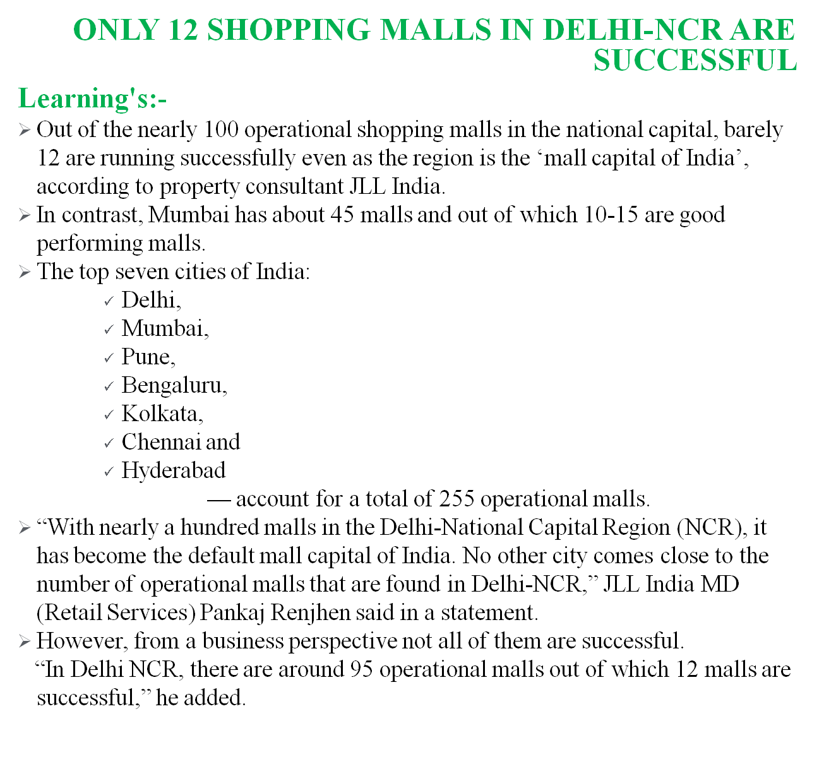

Slide 49
  Nevertheless, Renjhen said: “Among all the above cities, Delhi-NCR is currently best placed for hosting successful, large-sized malls.”
  Despite tough competition from other malls and high-street retail, the consultant said that only four malls closed down while one got converted into office space.
  The success rate of malls varies, usually depending on factors like design and layout, the mall’s brand positioning, location and how well they cater to the needs of their target segments.
  “Also, whether or not they have been able to evolve into family destinations rather than just remaining shopping centers' plays a big role.”
  JLL said that some of the most successful shopping malls in NCR, such as
      Select City Walk in Saket,
      Ambience Mall on NH 8 Vasant Kunj,
      DLF malls in Saket and Vasant Kunj,
      Pacific Mall in West Delhi and
      MGF Metropolitan Mall on MG Road, Gurgaon,
  — employ professional tenant management teams.
  These teams decide on the brands to be leased spaces in these malls, placement of different retail stores, branding, and promotions and customer outreach events in the atrium.
  They are involved in design and layout of malls as well.

Slide 50
7 WAYS TO PUMP UP YOUR RESUME
By:- CAREEREALISM
Learning's:-
Hiring managers have to read over hundreds of resumes each day. They all start looking the same, as you can imagine. What does it take to write a strong, compelling resume that will catch their attention? Pump up your resume to make sure you’re considered for the position you want.
That’s the prize-winning question! Because hiring managers, recruiters, or HR assistants are individuals, they have different things they find appealing. What works for one, might not work for the next. But, there are some universal qualities that comprise a “good” resume that will appeal to the vast majority.
And, that’s what you’re shooting for. Something that gives your resume a better chance of getting read than the other resumes that are putting these poor folks to sleep. You want to improve the statistical probability that your resume will be selected for an interview.
Here are some safe bets for turning your light-weight resume into a heavy-weight contender. Nothing crazy here, folks, because you don’t want to stand out in a bad way!
For the right kind of attention, try these ways of pumping up your resume.
1. Avoid Using A Template
“Using a template will never make you stand out and chances are
your application will be cut short due to your resume being the same as
every other job seeker’s.” Your resume should have a unique design.

Slide 51
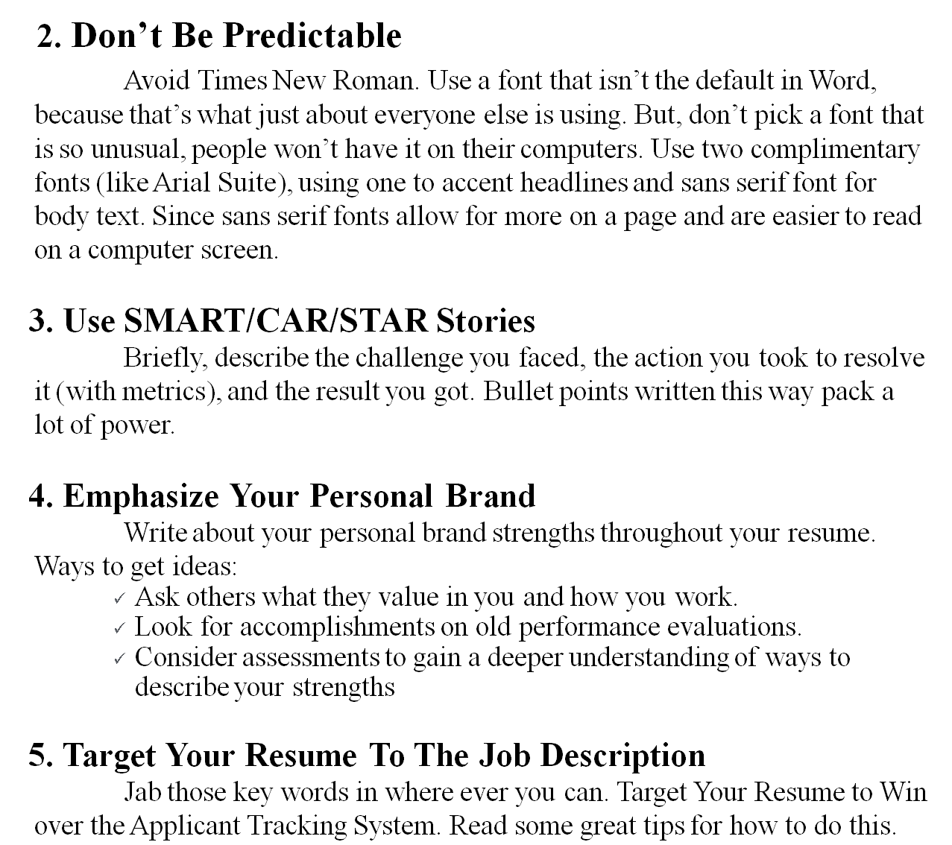

Slide 52
6. Know Your Resume Grammar
Resumes are written in first-person, but omitting pronouns (I, me, my, etc.). To avoid confusion, use only the past tense. Other weird resume rules are omitting articles like “the,” “an,” and “a,” using a serial comma, and using an endash (not a hyphen) between numbers.
Along with this proof read! Read aloud, backward. Have an editor check it over. Do a “find” search for words to delete such as, “the,” “a,” “an” “I,” “me,” “my,” etc. Turn on the “show/hide” button to see extra spaces.
7. Put Your Best First
To really knock out your competition, don’t save the best for last! Front load each bullet point, putting the biggest part of the success first. Like this-
Before: Navigated intense challenges of recruitment to onboard astounding 17
director-level and researcher recruits.
After: Brought onboard unprecedented 17 director-level and researcher
recruits, navigating intense recruiting challenges.
You can also frontload your document with your biggest accomplishments in the summary. Don’t wait to hook them with your greatness! Put it out there right from the start.
Employers want to know what sets you apart! Why should they hire YOU? If your resume lands you an interview, but there’s another candidate you’re sparring in the ring with, it could be your amazingly strong resume
that puts you over the edge and wins you the job.
That’s the sweet science of pumping up your resume.

Slide 53
58% EMPLOYERS CAN’T FIND THE RIGHT TALENT IN INDIA: MANPOWER SURVEY
By:- LIVEMINT
Learning's:-
  Accounting and finance positions are the toughest to fill – say many Indian employers.
  More than 50% of all employers in India face a talent crunch, even though the incidence of firms finding it tough to hire the right people dropped compared to last year.
  According to a report by global consultancy firm Manpower, 58% of employers in India surveyed reported a talent crunch. This was 6 percentage points lower than the previous round of the survey conducted last year. Yet, India’s talent shortage remains more acute when compared to the global average.
  Globally, 38% of employers reported a talent crunch, while across Asia, 48% of those surveyed said they faced a shortage of skilled workers.
  “Japanese employers continue to face the most severe shortage, with 83% saying they encounter difficulties. Elsewhere in the region, lack of appropriately talented candidates is most likely to be a concern in –
      Hong Kong (65%),
      India (58%),
      Taiwan (57%),
      Chinese (24%)
  However, talent shortages are least likely to cause difficulties for the
  Chinese employers” said the survey.

Slide 54
  In Asia, the toughest job to fill is that of a sales representative, which has historically been the hardest job to recruit for, said the survey.
  Vacancies for
      Engineers,
      Technicians and
      Information technology (IT)
  professionals were also in the list of top 10 toughest jobs to fill in Asia.
In India, however, the scenario differs.
  Accounting and finance positions were the toughest to fill, said Indian employers who were surveyed.
  This was followed by positions for:
      IT personnel,
      Secretaries and office support staff,
      Teachers and
      Engineers.
  Indian employers also reported difficulties in filling positions for:
      marketing professionals,
      communications professionals,
      legal staff and
      researchers.
  “The skill gaps are most obvious for employers seeking candidates with relevant industry-specific skilled trade certifications, with 13% identifying
  this as a key area of skill deficit, up from 9% in 2014,” the report said.

Slide 55
6 TIPS TO HANDLING A JOB OFFER
By:- CAREEREALISM
Learning's:-
It’s not every day that a job offer comes around. When you do get that phone call from your dream employer on a job offer, you’re thrilled! In the moment you must be feeling a rush of adrenaline, but with every job offer that comes around, it’s absolutely necessary to have a clear head in evaluating what the offer includes. Know how to handle a job offer professionally while you evaluate it using these tips.
1. Express appreciation and enthusiasm
Whether this is your top employer of choice or not, when you get a job offer always express appreciation and enthusiasm. Someone who comes off less than thrilled will make the employer question whether they have chosen the right candidate.
2. Ask that it be in writing
When you have the job offer in writing, it makes it more official. You can also clearly review the details so there are no questions left up in the air.
3. Agree on a deadline to respond back
When a job offer is extended it is fine to take some time to think about a decision, but come to an agreement with the employer on when that may be. At minimum the employer should be agreeable to 24 hours, but a day or 2 more is not unreasonable. The point is you don’t want to leave the
employer waiting in the dark on your decision.

Slide 56
4. Get lingering questions addressed
Find out who you can speak to if you have any questions. It’s best not to assume – get clarity on any questions you may have. If you are really struggling with coming to a decision and it may help to meet with more team members, put in the request immediately to the employer.
5. Negotiate, but don’t be greedy
Negotiation should always occur over the telephone or in person – not on email. It’s fair to negotiate for what you believe is reasonable considering your research of what’s industry standard. The problem arises when job candidates get greedy. For example, if you ask the employer to meet you at a higher amount on salary and they accept the request, don’t go back asking for even more. It’s unflattering on job candidates and may even wave some employers to rescind on the job offer.
6. Don’t bother pushing on things that are non-negotiable Some things are simply non-negotiable with employers. If the employer has stated those are firm rules, don’t push on it any further. See if there are alternate means to making things work like a shift in work hours for certain days so you can either start the work day earlier or later.
How you deal with a job offer can strengthen or dampen the relationship you have with the employer. Keep your dealings with the
employer courteous and professional. You want to build on a positive relationship whether you choose to accept or decline the job offer.

Slide 57
  4 TIPS FOR BECOMING THE CO-WORKER EVERYONE LOVES By:- CAREEREALISM
Learning's:-
  Every employee dreams of working in an environment where positivity resonates. Where people are supportive of each other. Where you feel motivated to work hard. You know you need to attract pleasant treatment before you receive it. Here are a few tips for becoming the co-worker everyone loves:
  1. Be Pleasant
  Remember the golden rule? Don’t do to others what you don’t want others do unto you. This also rings true in the workplace. If you treat people around you coldly, and refuse to share even a smile, then you could as well expect your colleagues to seem distant. Although people will have varying attitudes, they can still work together well. It takes open-mindedness to survive and thrive in such environment. So, learn to look past differences. Accept others as they are. Show kindness. It will be returned in situations you need it the most.
  2. Be Innovative
  It is easy to live on your own while in the workplace – minding your own tasks, limiting talks with your colleagues and going straight to home after work. Your motivation to go to office everyday is the paycheck you receive. You comply to what you’re told to do, but do not really extend efforts going beyond what is expected of you.

Slide 58
  3. Respect The Bosses
  They can sometimes be difficult. They, sometimes, reach out to the team as though they’re on the same rank with them.
  Bosses are not created equal. They may be using different approaches to inspire their team. There are times when you would find their rules too stringent, or perhaps lax.
  However, they act. Remember, they are your superiors, your leaders. Even if, at times, you might find their behavior uncalled for, never speak negatively about them to your colleagues.
  If there is anything you need to say, tell it straight to them. This is not to say that you smarm your boss, however, it would help that they have a positive impression toward you.
  4. Sustain Healthy Competition
  How do you look at your workplace? Is it something you see as a battlefield, with all your colleagues as your enemies? Is it a place you call your second home with people you deem as your other family? Is it a haunted mansion with everyone around acting like zombies?
  It’s okay to be competitive. But to aspire for progress so much that you’re already building barriers from your colleagues can be harmful.
  You are a team still, and to get ahead doesn’t mean you’d need to leave
  people behind or hanging.
  Do your best while reaching out in any way you can to your colleagues.

Slide 59
3 TIPS FOR LANDING A ‘PERFECT FIT’ JOB
By:- CAREEREALISM
Learning's:-
Maybe you’re a working professional who’s tired of your current position and craves a career change. Or maybe you’re a career nomad who hops in and out of jobs, never quite finding that “perfect” job. Finding that ‘perfect fit’ job can be a long and hard journey – but not if you know where to look! In fact, it’s easy once you know what you’re looking for.
Here are three tips for finding the ‘perfect fit’ job for you:
1. Get advice from professionals who’ve actually held the position
Before you commit to your job search, you need to have an idea of what kind of job you want. A great way to do this is to learn more about specific jobs from people who’ve actually HELD the jobs. They’re the best ones to give you insight on the job, tasks, and general expectations to see if it’s really a good fit for you.
There’s a great site called SecureTheJob.com that helps you find this valuable information. It’s a community platform that uses the give-to-get model, so the site is free, but users must share a piece of career advice about a job they’ve had before they have free-run of the site. SecureTheJob is the only site of its kind – it’s a great way to find the specific advice you need as well as “pay it forward” by providing some insight on positions you’ve held previously. It’s a win-win.

Slide 60
2. Make a list of target companies
What type of job you want – great! WHERE you want to work. Think about location – where do you want to work geographically? Think about the culture – are you looking for a competitive atmosphere or a more relaxed one?
Once you have your list of target companies, you can start doing some research on them. Glassdoor.com allows you to find great information such as employee reviews, average salaries for positions, and job interview reviews for specific companies. Having this information will help you narrow down your list so you can focus on the companies you think are a good fit for you.
3. Get to know them
Go to their company website and check out staff page, if they have one. Think about who you’d be working closely with if you were to land a job at that company, then reach out to them via LinkedIn – Introduce yourself, briefly note your interest in working at the company, then see if they’d be open to having a quick conversation with you to help you learn more about the company.
Note: Do NOT ask for a job. You’re asking for a conversation. Remember, if you want to land a ‘perfect fit’ job, you need to do your research. You need to know who you’ll be working with and have some insight on the projects you’ll be working on. The best way to do this is to set up an informational interview with someone who actually works there. Some tips
on setting up informational interviews with employees at your target companies. Use their social channels to get to know them. Hopefully, you find these tips helpful in your job search!

Slide 61
THANK YOU!

